Slide 1

AI RISK AND THREAT MODELS
ALFRED OBIA
Threat Analyst
Threat Analysis
IT Audit
AI Security Testing
Blockchain
App Security
CTF

Slide 2

The Hook
The Crisis of Confidence
Real-world AI system failure
biased hiring-gender,race
adversarial attack
AI is not just a technology risk; it's a fundamental Control Breakdown

Slide 3
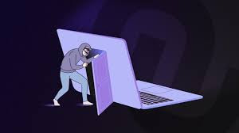

The Threat
Indirect Prompt Injection
Beyond the Firewall
Backdoor Attacks in the AI supply chain-NPM postmark-MCP
Fine-tuning misalignment
AI RISK CONSEQUENCES
Financial Damage
Litigation Risk
Reputational Damage

Slide 4

The Audit Imperative
Reframing Risk for Governance
Translate AI risk models
into audit challenges
Digital Operation Resilience Act, DORA 80%
Data quality
AI Expandability

Slide 5

Conclusion: The Call to Action
The Auditor’s New Mandate
Lead the fight in AI assurance
Adopt Continuous, Real-Time Monitoring
Develop AI expertise (e.g., ISACA AAISM/AAIA)
Bridge the gap between AI development and assurance

