Slide 1
AI Transformative Power: Opportunities & Risks
Peter Kakoma
2nd Oct - 2025

Slide 2
“Because the purpose of business is to create a customer, the business
enterprise only has two basic functions: Marketing and Innovation. These
produce results; all the rest are costs. Marketing [innovation] is the
distinguishing, unique function of the business.”
– Peter Drucker, the Father of Business Consulting

Slide 3
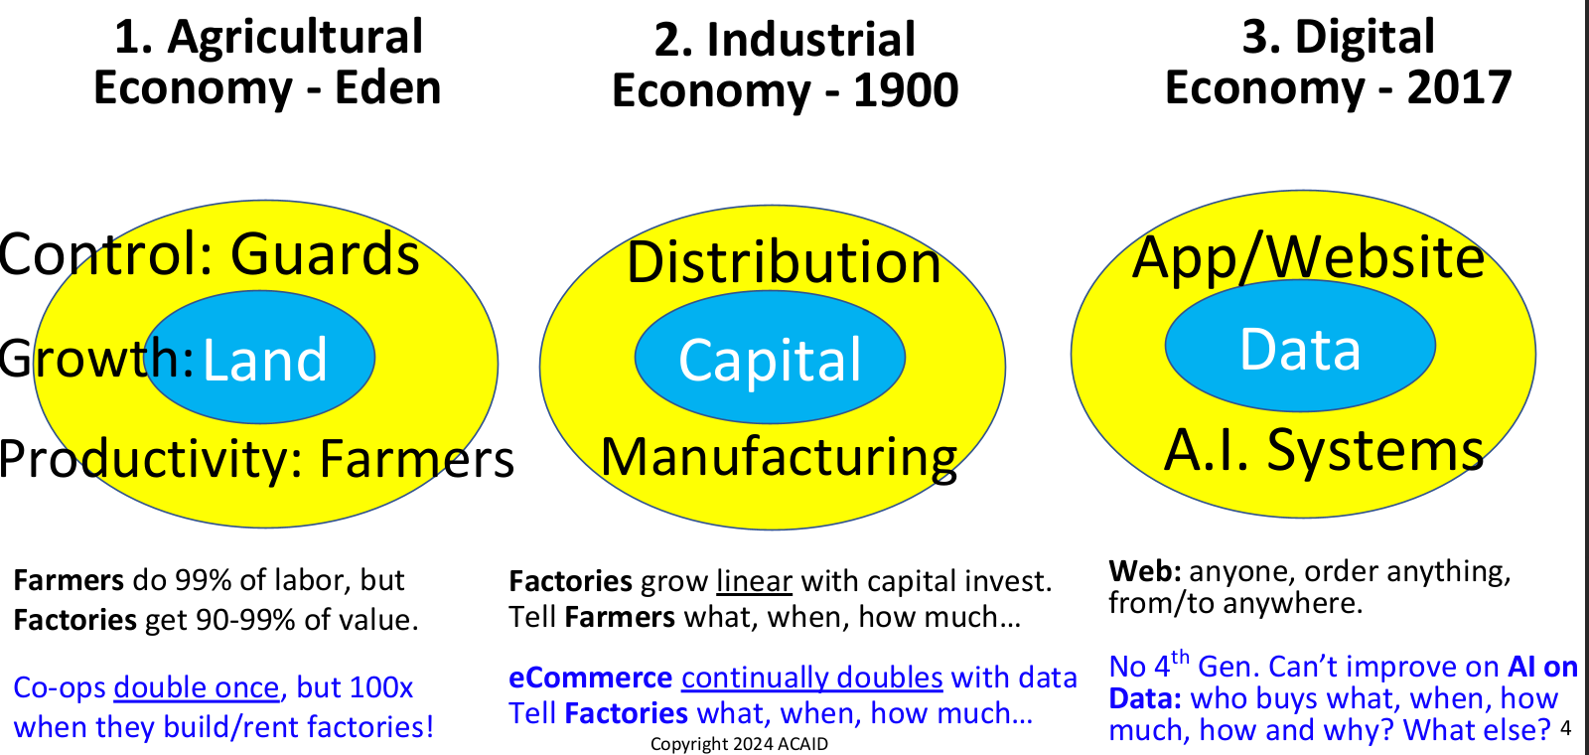
Economic Generations

Slide 4
Why is Data first, not AI?
Because Data is:
A. Hyper-exploding 3V (Volume, real-time Velocity, media Variety) here, and
B. Control: There is no AI (automated driver) without Data (value dashboard)

Slide 5
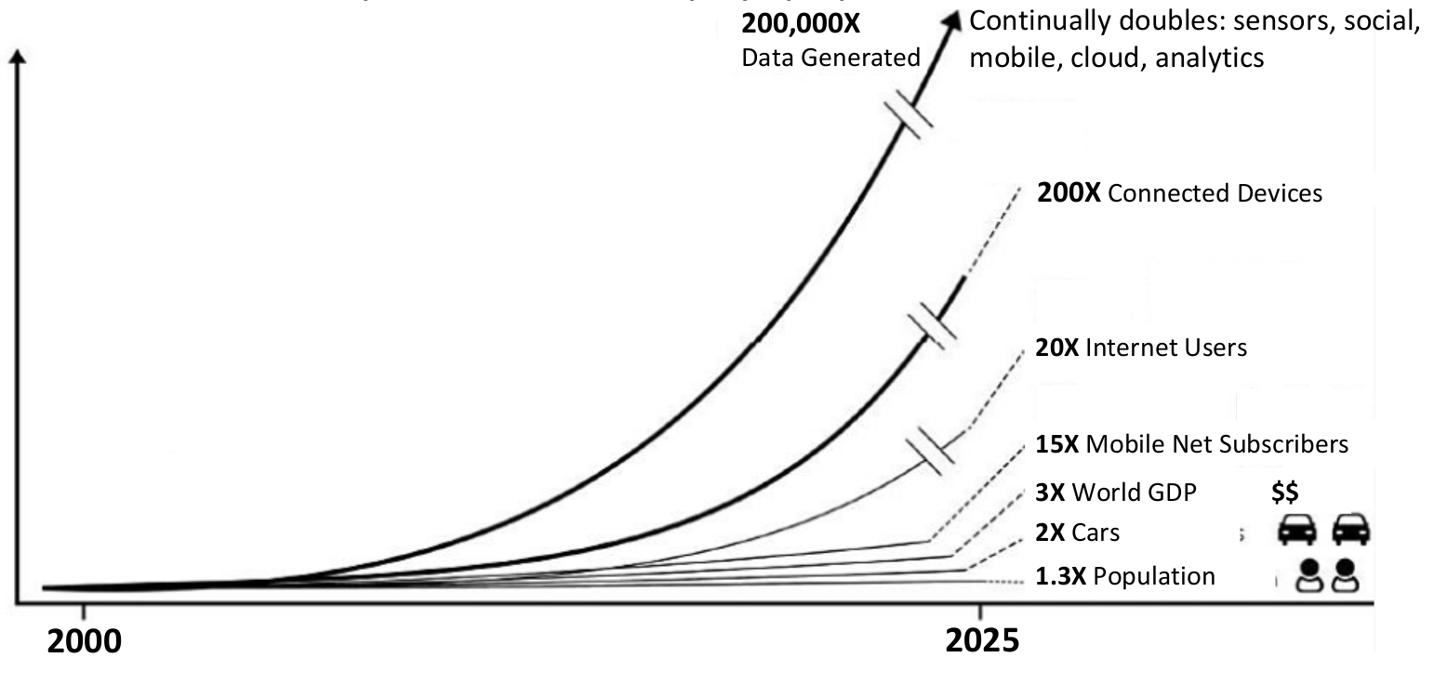
Why is Data first, not AI?

Slide 6
Parato 80/20 and 64/4 Rules
Problem: 70% of Data/AI projects fail* from data explosion 200,000x in 20 years
Solution: Business must Parato focus on the 4% of data that provides 64% of business value. The 4% most valuable business Use Cases (UC) drive data stack top-down design.
Parato 80/20 rule claims 20% of the work yields 80% of results.
Do Parato on Parato means 4% of work yields 64% of results, called Parato 64/4 rule
Parato rules are true across many business, data, and AI opportunities.

Slide 7
To take advantage of opportunities
New Business: The revenue & innovation center, pace of business cycles (strategy to execution), next gen talent*
Needs Exec protection: For disruptive end-to-end transformation: data stack, its org, & entrepreneur leadership* drives change
New Process: Tech first, data/analytics, MVP driven (rapid A/B Testing), 2
speed: short term profit and long-term growth, biz KPIs
Needs Digital Skills: Global delivery, direct to customers (D2C), emerging
skills*, understand digital natives who demand quality*

Slide 8
Identify Valuable Data
Customer: increase value and sales at every customer contact: store, web, contacts…
Starbucks increased sales 300% adding AI engine to CRM for these.
To Monetize Data: Keep Asking Customers what they want & how much they value it.
Actionable: identify data or AI-driven closed loops like thermostats, smart parking,
smart anything (called OT: Ops Tech) for productivity or automation.
Analytics: Multi-variable statistical optimums on structured data (SQL, multi-dim star
joins)
AI: RAG framework on LLM integrated with OpenAI: any type, any vendor pipeline,
any expert feedback, any recommendations, expose for prompts, and automate any
of this*
Innovation: What new and valued data/AI opportunities for above?

Slide 9
Keep Data Monetization in Africa
Like Industrial Age 100x wealth urgency, one generation decides Data
gatekeepers
So: Contracts, API, Encrypt data, Patents

Slide 10
After Data Control and 4% Focus - Grow Data sources
Direct to Customer (D2C): Specialize to beat larger, global players
CRM: www.ActiveCampaign.com Customer Resource Manager data for
campaigns, sales, market, support… Pipeline: Prospects, to Close Efficiency, to
Max Lifetime Value
Apps: Franchise, Data/AI or Communities. All clients’ data, entire chain
Sensors: internet of things (IOT) to machines (M2M) or human dashboards
Web: WordPress with WPForms. Add WooCommerce data for eCommerce,
MemberPress for Community or eLearning.
Google: All B2C (Business to Consumer) companies need a Google Data expert.
Since Google majority in client: phone, Browser, Search, Ads, maps, etc. Integrate
with CRM.

Slide 11
CRM as Data Source
Campaign: The right customer, through right channel, right message, right incentive,
at right time, right sequence.
Customer: Situational profile, demographic, digital tools, regional variations
Pipeline: identify prospects, close sales, maximize lifetime value
Channels: Web, email, CRM, Social Media*, call center script, app notification,
SMS, newsletter, text, store counter pop ups. Tagging
Message: phrasing, tone, images, font size, colors, etc.
Incentive/motivation: risk of loss, coupon
Time: two weeks notice, two-day reminder. Customer Personalization

Slide 12
Mobile App Data and AI
Apps generate 1000x more data & AI value than Web. Flutter is best App dev.
Terms & Conditions monetizes all data sources. API leverages better phone’s compute & memory.
eCommerce with App: App sales, delivery, finance, insure… 1,000s customers
Freemium: App to Max Users. See Google Play store’s popular Freemium with Pro version.
Expected revenue: 70% freemium, 20% Pro, 10% data sales
Social Media, Community: App rewards sharing data, growing memberships.

Slide 13
Companies Hyper-Scale with AI Skills!
Everyone must be an 1. AI User! Hire and retain AI users with max Productivity
& decisions from Prompt, Context, Agents and requirements to make others
productive: 2. AI Devs, 3. AI Engs and 5. Data Engs.
Must employ AI Dev(s)! Who can code AI-First & max AI Models for Users,
via Scripting API, Agents external Tools and RAG external Data
Must invest profits into owning Data

Slide 14
How is GenAI (2017 Attention-Only Algorithm) Learning Better?
100x* sooner value. Next: $T investments (45% of 2025 USA VC Funds)
100x less hardware. Next: custom ASIC for another 1000x
100x quality of results. Next: algorithm improvements & flexibility
All receptors (analog sensors) for input and output, not just text. Ex:
Combine multiple human senses for any input and output.
API: for productivity and automation. Next: all standard: MCP, A2A,
API, Prompts…
Agent: any proactive tasks on any environment via LLM & human goals
Continually doubles generative knowledge every 4 months. Next:
hyper personalized, segmented

Slide 15
Great Prompts: Goal, Role, Audience, Format, Set
Good: “Create a lesson on DNA for high school students.
Great:
“Design a lesson for 10th grade students introducing the structure and function of DNA. You are a high school biology educator. Tailor the lesson for an inquiry-based science class, include an engaging lab activity and provide a claim-evidence-reasoning (CER) writing prompt as the exit ticket.”
Why it’s great (GRAFS):
It defines a learning Goal/Task: DNA structure and function
clear Role: high school biology educator, and
target Audience: 10th grade science class.
It also Sets style/tone: a pedagogical approach and
specifies output Formats: like a lab and CER prompt

Slide 16
Prompt AI – the limit is our imagination
Exercise: How can I grow House Cleaning business 100x in 3 years?
Detail a house cleaning service, where customers can live 11 years
longer.
How can I find all customers who have lots of money, but no time?
How could I expand into other time services, like lawn care, laundry,
car wash, dog walk? Which are most profitable?
How could I Franchise this business this year?
How could mobile app double Franchisee sales?
How could AI on app data double sales again?

Slide 17
GenAI Value predictions by 2026
GenAI will significantly alter 70% of design and dev for new Web and Mobile
apps.
Over 80% of Enterprises production environments will use GenAI APIs and
models and/or deployed GenAI-enabled apps, up from less than 5% in 2023
20% of repetitive processes will be automated by domain-specific GenAI
implementations in Every Industry.
30% of outbound marketing messages from large organizations will be
personalized using GenAI tools, up from less than 2% in 2022.
AI Agents leveraging text-to-video using GenAI will support 70% of digital and
marketing communications, up from less than 5% in 2022.
More than 30% of new drugs and materials will be systematically discovered
using generative AI techniques, up from 0% today.
Notes:
www.gartner.com/en/doc/779868-emerging-tech-top-use-cases-for-generative-ai also see
www.gartner.com/en/articles/generative-ai-can-democratize-access-to-knowledge-and-skills

Slide 18
GenAI Use cases by Job domain
Function | Use-Case Examples
 | Chatbots | Virtual assistants | Digital humans
Customer Service | Chatbots | Virtual assistants | Digital humans
Finance | Risk assessments | Financial sentiments | Modeling, pattern/trend analysis
HR | Faster document development, create interview questions | Summarize employee survey results and suggest employee engagement activities | Write offer letters and job descriptions
IT | Generation of code and convert code from one programming language to another | Translation and explanation | Verification of code
Legal | Standard rent agreements and NDAs | Create draft compliance policies and training material | Contract analysis
Marketing | Content creation | Personalized engagement | Automate video editing processes
Operations | Reduce repetitive, mundane tasks for staff | Quality control and defect detection | Predicting demand patterns
R&D | Generate synthetic data for research | New architectural designs | New product development given constraints
Sales | RFP response generation | Product cross-selling opportunities | Global logistics improvement
Notes:
Gartner-779868-emerging-tech-top-use-cases-for-generative-ai.pdf (July 2023)

Slide 19
Risks
New Power: AI generates very accurate personal profiles from a few
bits of digital data.
Example: Cambridge Analytica used public Facebook Likes to predict
ethnicity, religious, and political views.
New Gatekeepers: AI to find customers, approve loans, prefer job
interviewers.
Example: Cambridge Analytica predicted personality better than
interviewers, including level of: open, agreeable, extravert, conscious,
and neurotic – called the Big Five.
Glaring Errors: disastrous consequences, bias, immoral.
Notes:
www.gartner.com/en/doc/779868-emerging-tech-top-use-cases-for-generative-ai also see
www.gartner.com/en/articles/generative-ai-can-democratize-access-to-knowledge-and-skills

Slide 20
AI Ethics
Australia Postal was fined $18M Euro for selling names, addresses, ages and
political party. Third parties extended these with home value, ownership rates,
street crime, etc. for focused customers and voter influence.
ClearView AI created facial recognition from billions of public pictures from
internet and social media. They sold access to law enforcement, who could find
matches for identity, address, and profile.
The sources never gave permission, so Australia and France had Clearview stop collecting and
remove photos from their countries. Facebook and others, abandoned their similar products.
China Communist Party calculates citizens loyalty score, affected by your friends’
loyalty
Target retailers predicted pregnancy from purchases, and sent early
advertisements to them, including mail that surprised parents who did not know.
Target's defense included they were legal with all international and country laws.
Notes:
www.gartner.com/en/doc/779868-emerging-tech-top-use-cases-for-generative-ai also see
www.gartner.com/en/articles/generative-ai-can-democratize-access-to-knowledge-and-skills

Slide 21

www.kanzucode.com

