Slide 1
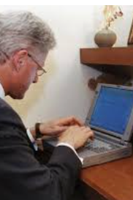
1994

Slide 2
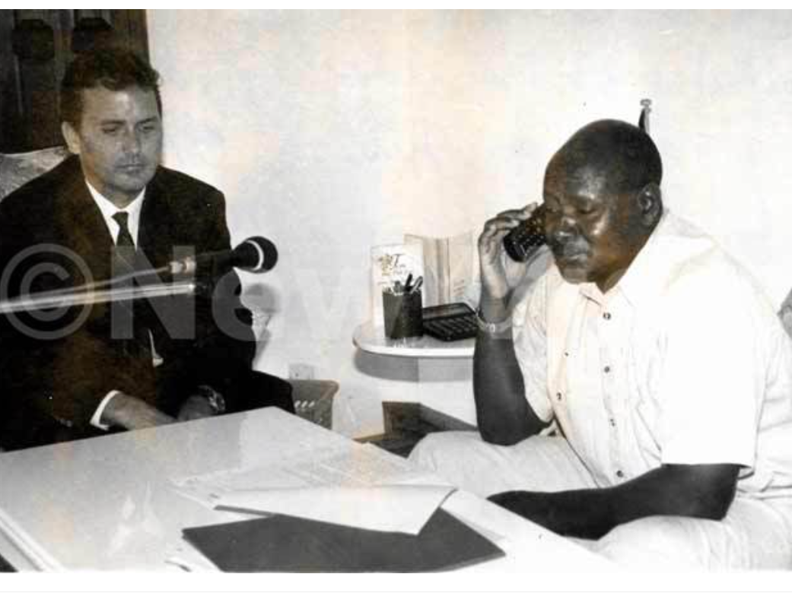
1995

Slide 3
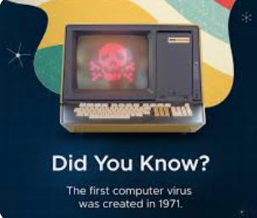

Slide 4
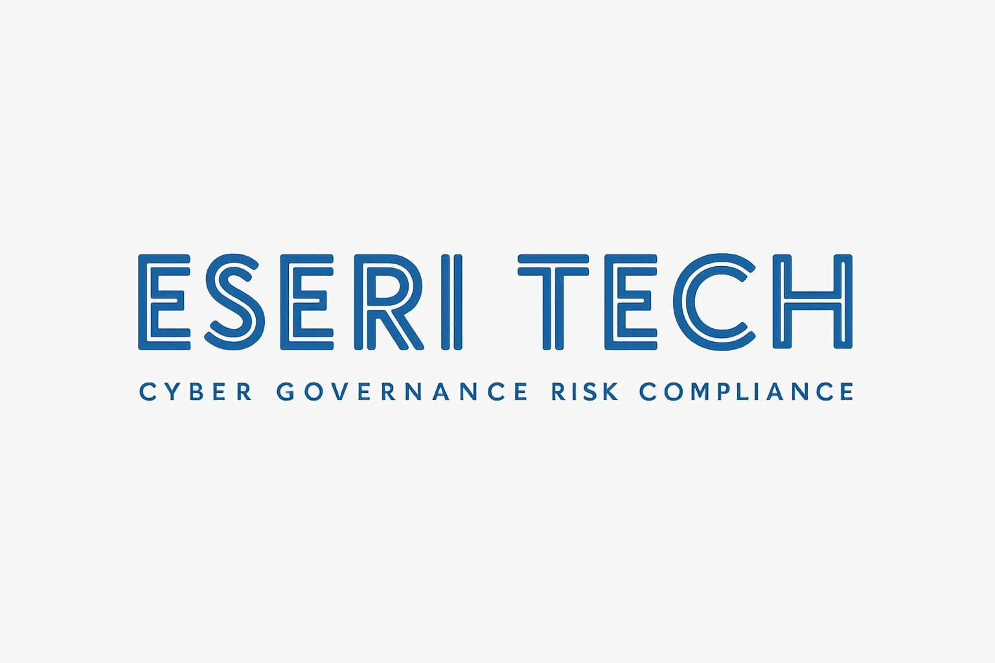
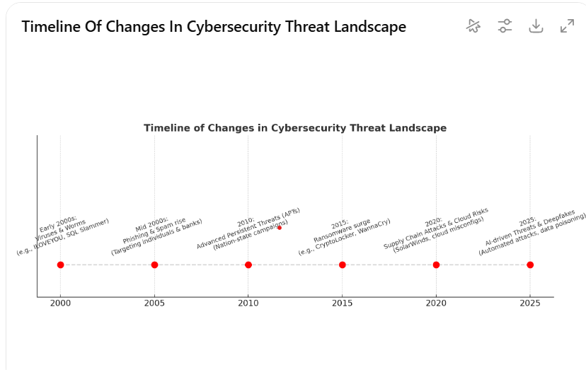
Changes in Cyber security threat landscape

Slide 5
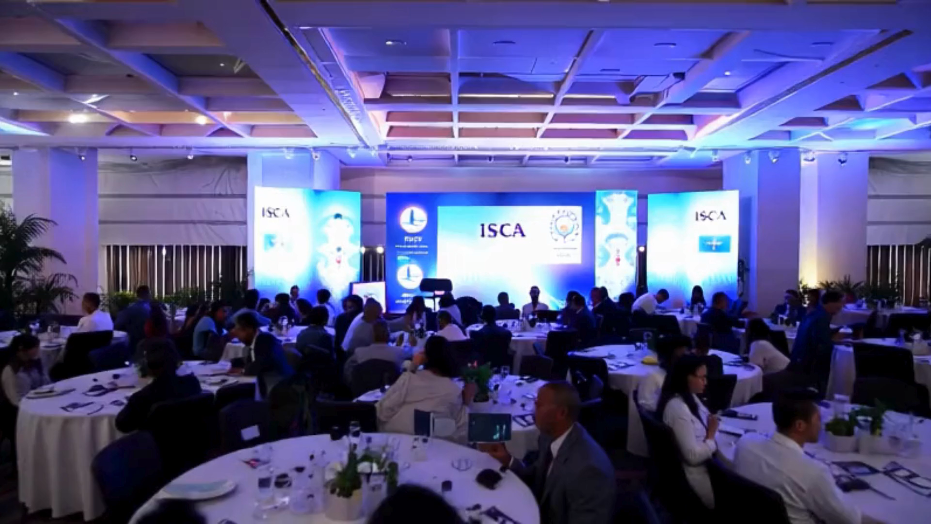

Slide 6

From ITGCs to Cyber Resilience: Evolving Audit Techniques for Modern Risks
Jennifer Kahirimbanyi – Director, Eseri Tech

Slide 7
ABOUT ME
Director at Eseri Tech, advising on Cybersecurity and AI governance, risk and compliance.
18+ years’ experience across financial services, energy, and hospitality sectors in Australia and Uganda.
Proven record in building cybersecurity governance frameworks that strengthen resilience.
Holds BSc, MBA, and certifications: CISA, CISM, PRINCE2, ITIL.
Passionate about enabling innovation while safeguarding security.
SERVICES
Governance & Advisory Governance Frameworks Risk Assessments | Compliance & Assurance • Audit Readiness Reviews • Framework Alignment (ISO 27001, NIST) • Third Party reviews
Training & Awareness • Awareness Programs • Phishing Simulation Campaigns • Executive & Board Resilience Workshops | Business Continuity & Resilience • Business Continuity & Disaster Recovery Planning • Incident Response Exercises

Slide 8

Agenda
Audit Methodology
Strategic Alignment
Prioritisation
Culture & Awareness
Third-Party & Supply Chain
Response/Recovery
Audit Techniques
Integrated Audits
Data analytics and real time monitoring
Pen testing/ Red team / Blue team

Slide 9

What would you like to get out of this presentation?

Slide 10
Strategic Alignment
Align audit plans and frameworks with business strategy.
Governance by design -embed governance and risk management in business processes eg during project planning phase.
Work across three lines of defense to ensure coverage of key areas (assurance mapping)

Slide 11
PRioritisation
Know your crown jewels: Understand your business critical processes, systems, data and exposure
Define and quantify the associated risks
Determine key controls and focus resources and activities on high priority controls

Slide 12

Culture & awareness
Measuring security culture
Reporting and escalation
Awareness training and phishing simulations

Slide 13
supply chain
Contract Clauses (Right to Audit, Reporting requirements)
Control testing on your instance of the third-party software
Understanding how third parties access your environment , how you share data securely

Slide 14
response and recovery
Disaster Recovery
Business Continuity
Recovery playbook and crisis management

Slide 15
Audit Techniques

Slide 16
Integrated audits
People
Process
Technology

Slide 17
Active Audits
Project planning
Embed security controls and secure architecture
Embed governance and control testing
Notes:
Active audits include getting

Slide 18
Data analytics and real time reporting
Automated checks and balances
Improved accuracy (from sampling to entire dataset)
Real time discovery and faster resolution

Slide 19
Adversarial simulation and testing
Penetration Testing
Red Team
Perimeter scanning

Slide 20
Key Take Aways
Findings to insights: Move beyond simply reporting audit findings—focus on generating meaningful insights by considering the broader context.
Shift left: Embed cyber security governance and controls early in the development lifecycle turning it into a proactive enabler. Audit/Assurance is not going to nor is it meant to catch everything. Systems should be in place to avoid errors in the first place, Prevention is better than cure.
What are you going to implement /review on Monday ?

Slide 21

Questions?

