Slide 1

From Securing Systems to Securing Decisions:
Redefining Assurance in the AI Age

Slide 2
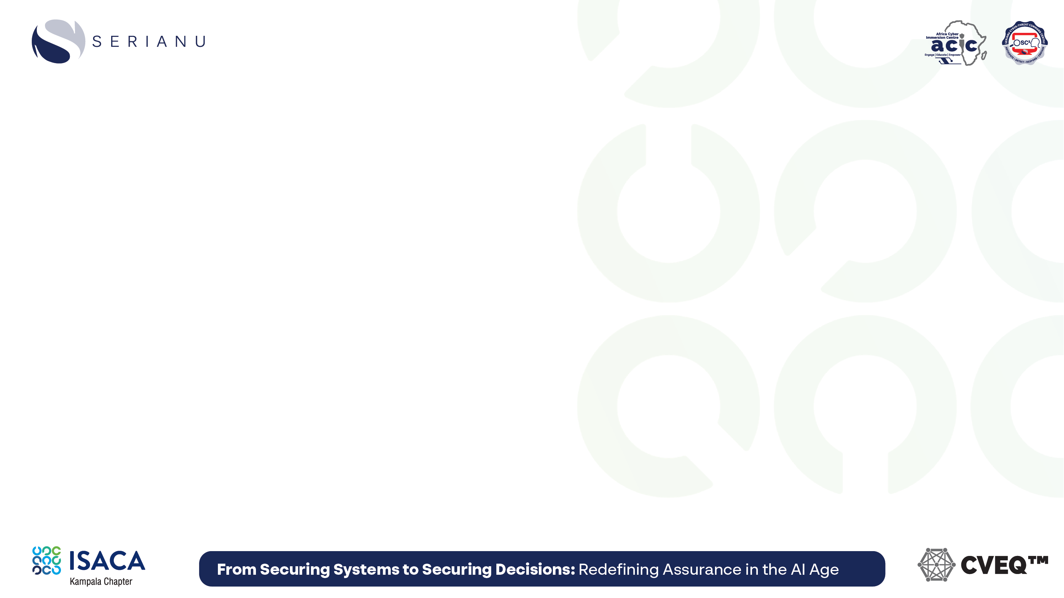

Design Assurance : Redefining Risk Oversight in the AI Age (Whitepaper)

Slide 3

Mega Africa CVEQ Resilience Scorecard (Sample Resilience Indicator)

Slide 4

CVEQ Resilience Scorecards Guidebook

Slide 5






What is Decisioning?
Decisioning = turning information into choices that drive action.
Every organization makes thousands of decisions daily.
Examples:
Bank → approve or decline a loan. Hospital → decide on patient treatment. Retailer → set product pricing. Government → decide who receives welfare benefits.
Systems process data.
Decisions create value.

Slide 6

Why Decisions Matter
Every decision affects:
Revenue → profit or loss.
Trust → with customers, regulators, partners.
Resilience → ability to continue under disruption.
Good decisions = growth, trust, resilience.
Bad decisions = losses, reputational harm, systemic risk.

Slide 7
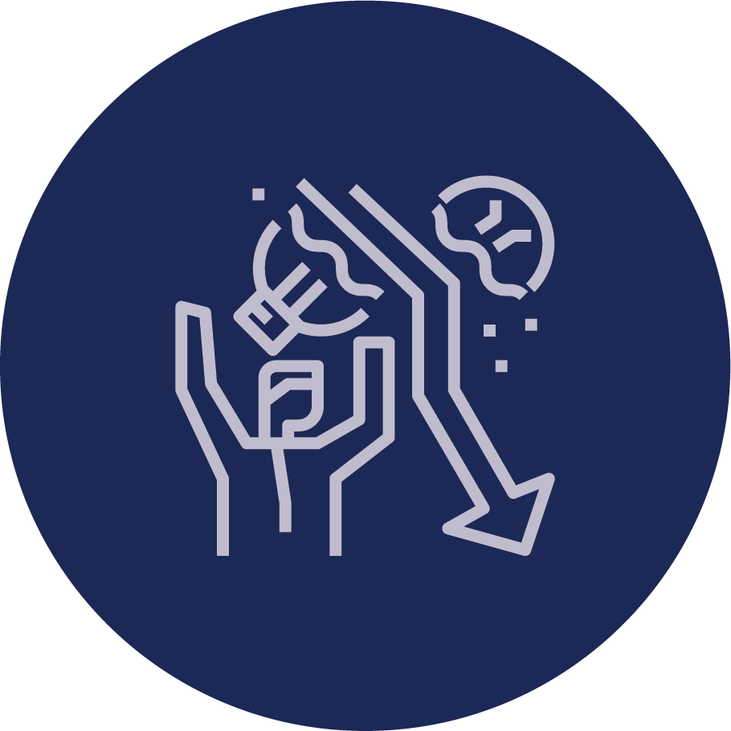
Why Decisions Can Fail
In the past → mostly human-led, trust was assumed.
Today → many decisions are AI-driven or AI-assisted.
New risks include:
Bias or unfair outcomes.
Model failures or outages.
Over-reliance on automation.
Lack of oversight or transparency.
We can no longer assume decisions are automatically trustworthy.

Slide 8
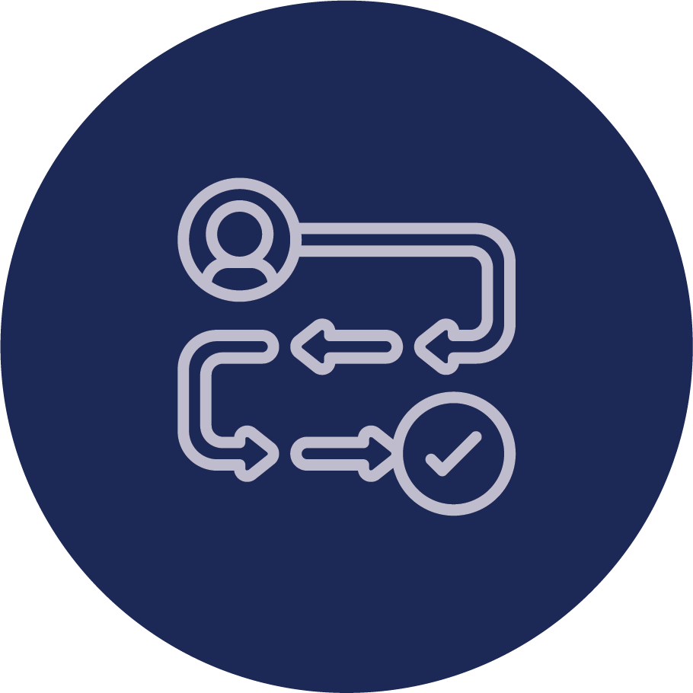
The Decisioning Journey
Data Era → Humans decided directly from raw data.
System Era → IT systems supported human decision-making.
Internet Era → Distributed systems enabled faster, broader decisions.
Analytics Era → Dashboards, BI, and early AI guided choices.
Autonomous Era (Today) → AI and automation now drive or heavily influence outcomes, with humans mostly overseeing.
Each shift increased speed and scale — but also increased risk.

Slide 9

From Brains to AI: The Decisioning Journey
Human Brains – Enabled humans to think, reason, and decide — but limited by scale and speed.
Computers – Enabled humans to store and process information.
Internet – Enabled humans to communicate and collaborate at scale.
Artificial Intelligence – Enables humans (and machines) to make decisions faster and more accurately.
Each wave expanded decision-making capacity — but also reduced dependency on natural intelligence, and increased dependency on artificial intelligence.

Slide 10
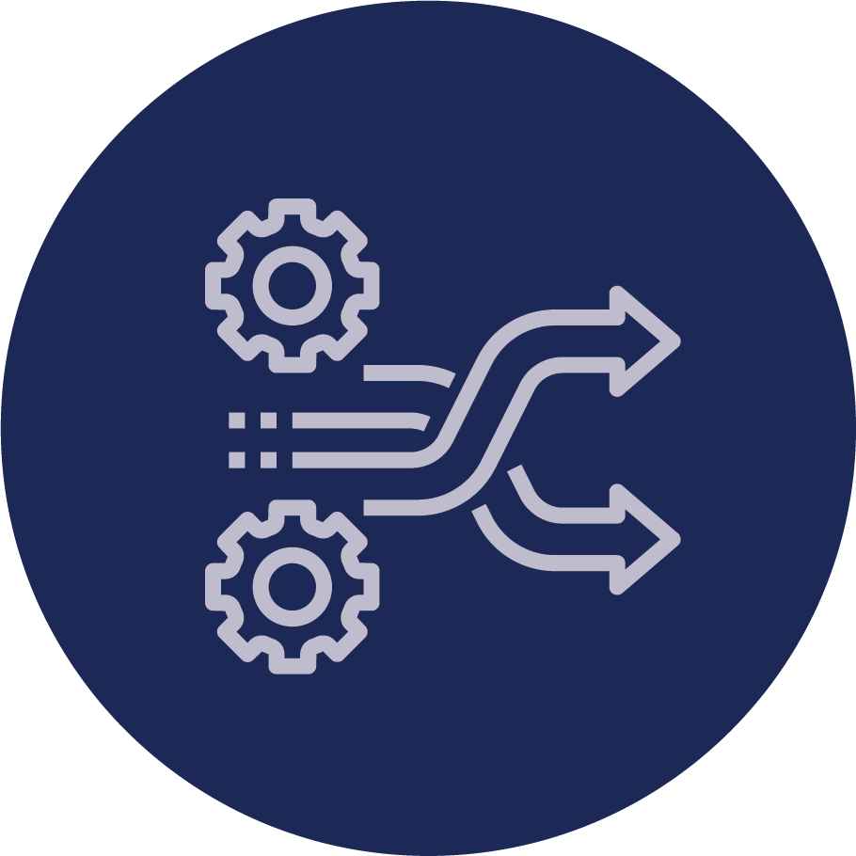
What Changed Over Time?
Data Era → Humans decided. Trust was implicit.
System & Internet Eras → Technology supported, but humans still decided.
Analytics Era → Humans relied on models, but oversight remained.
Autonomous Era (Today) → Machines now decide or strongly shape outcomes.
Trust in decisions can no longer be assumed — it must be proven.

Slide 11

What is Decision Assurance?
Decision Assurance = confidence that decisions remain reliable, fair, and resilient — even under disruption.
Evolution of assurance:
System Assurance → Are systems secure?
Digital Assurance → Are data flows reliable?
Decision Assurance → Are outcomes trustworthy?
Decision Assurance extends trust to the outcomes that drive business value.

Slide 12

Why Decision Assurance Matters
Boards & Executives → Confidence in governance and resilience.
Executives & Leaders → Clear priorities for investment.
Risk & Cyber Teams → A framework to measure and close gaps.
Regulators → Evidence of systemic resilience, not just compliance.
Customers & Citizens → Trust that outcomes are fair and reliable.
Assurance is no longer about IT health — it’s about business trust.

Slide 13

Why Indicators?
Modern decisioning environments are complex → infrastructure, systems, AI, people, third parties.
Single reports or one-off audits are not enough:
Too narrow → miss the bigger picture.
Too slow → issues emerge between audits.
Too shallow → compliance ≠ resilience.
Organizations need continuous, multi-dimensional signals of trust.
Indicators are the health signals of decision assurance.

Slide 14
The Six CVEQ Indicators
1. Profile – What matters most: processes, data, assets.
2. Maturity – How structured and consistent governance is.
3. Visibility – Do we clearly see risks, controls, and exposures?
4. Exposure – Real-time vulnerabilities, threats, and disruptions.
5. Compliance – Alignment with laws, standards, and policies.
6. Resilience – Ability to withstand and recover from disruption.
Six lenses, one truth: are our decisions resilient?

Slide 15
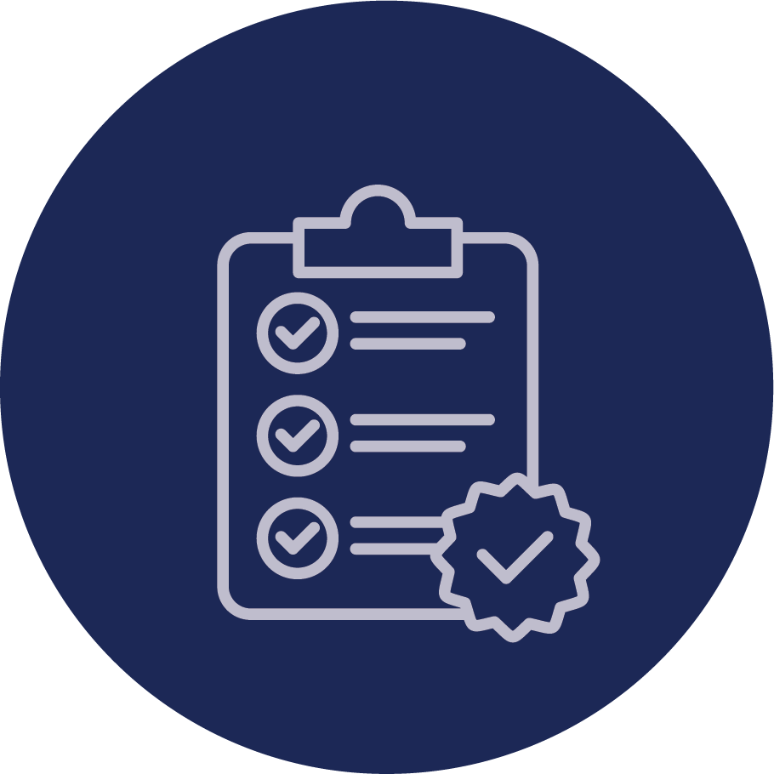

Introducing Resilience Scorecards
CVEQ Indicators provide the measurement foundation.
Leaders need a way to see, compare, and communicate results easily.
Resilience Scorecards:
Summarize six indicators into a single view.
Show resilience against loss categories and scenarios.
Present results as percentages and grades (A–D).
Resilience Scorecards turn CVEQ indicators into clear decision signals.

Slide 16



Bridging Tech and Business
Technology Risk Leaders (CIO, CRO, CISO) focus on:
20 Control Design Capabilities (CDC) → preventive strength.
25 Threat Detection Capabilities (TDC) → detective strength.
Boards & Executives focus on:
4 Loss Categories → Financial, Service, Data, Trust.
24 Loss Scenarios → fraud, outages, breaches, mistrust.

Slide 17
Bridging Tech and Business
The Bridge:
Resilience Scorecards translate CDC/TDC performance into loss scenario resilience.
Results expressed as percentages and grades (A–D).
Create a shared language for both sides.
Scorecards converge two worlds into one conversation.

Slide 18
Anatomy of a Resilience Scorecard
Each scorecard shows:
Overall Resilience Score (%) – benchmark from 0–100.
Grade (A–D) – mapped directly from CVEQ scale.
Loss Categories (4) – Financial, Service, Data, Trust.
Loss Scenarios (24) – detailed events within each category.
CDC + TDC Links – technical root causes of resilience gaps.

Slide 19
CVEQ Grading Scale (Guidebook p.17):
Resilience % | Grade | Interpretation
91–100% | A (Very High Resilience) | Fully resilient; negligible gaps remain.
76–90% | A- (High Resilience) | Strong resilience; only small gaps remain.
61–75% | B (Moderate Resilience) | Moderate resilience; notable weaknesses remain.
46–60% | C (Low Resilience) | Limited resilience; significant weaknesses remain.
0–45% | D (Very Low Resilience) | Very weak resilience; organization highly exposed.
Boards see grades. Tech teams see causes. Both align on priorities.

Slide 20

Why Resilience Scorecards Matter
Boards & Executives → Benchmark resilience in clear business terms (loss categories & scenarios).
Technology Leaders (CIO, CRO, CISO) → Show how CDC and TDC performance links directly to business exposure.
Regulators → Gain a consistent way to compare systemic resilience across institutions.
The Organization → One shared language that aligns business and technology.
Resilience Scorecards are not just reports — they are the bridge between technical risk and business risk.

Slide 21
Design Assurance – Session Resources
Design Assurance : Redefining Risk Oversight in the AI Age (Whitepaper)
Mega Africa CVEQ Resilience Scorecard (Sample Resilience Indicator)
CVEQ Resilience Scorecards Guidebook

Slide 22


