Slide 1
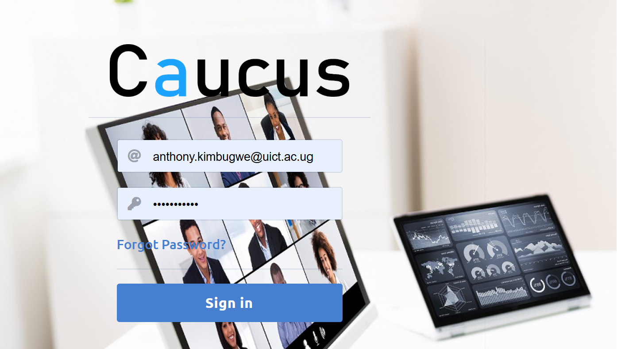
CAUCUS ANYWHERE SYSTEM FOR ELEARNING & ONLINE COLLABORATION
https://live.uict.ac.ug

Slide 2
Introduction
CAUCUS virtual classroom tool.
Locally developed online collaboration and video conferencing tool whose development was supported and approved by MoICT for use in Uganda.
Users: 60 support staff, 100 lecturers and over 1000 Long term students; 5,000 Digital Literacy participants across 30 districts in UG
Caucus is comparable to zoom, skype, Microsoft teams, Google meet; but customized for an individual Institution, fully owned by the Institution and system stored on their own servers

Slide 3

Getting Started
Join via link or LMS
https://live.uict.ac.ug/
Works best on Chrome/Firefox
No installation required

Slide 4
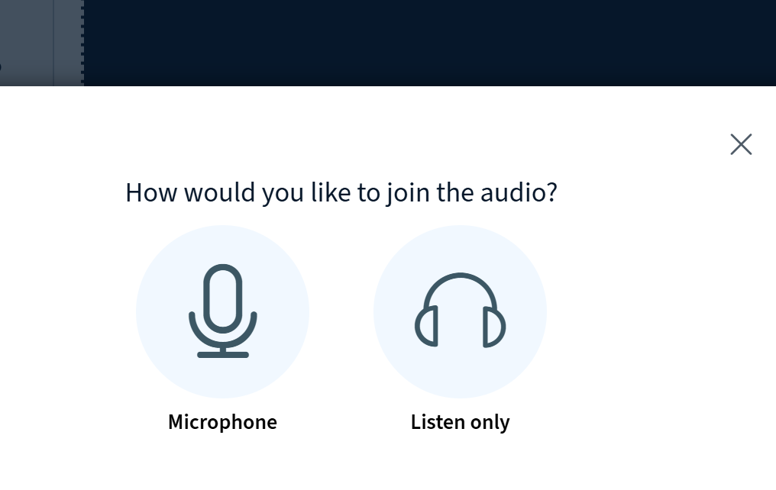
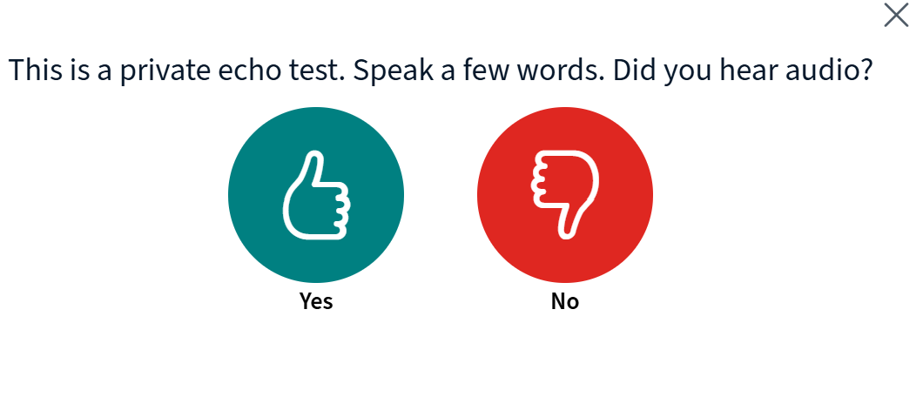
Audio & Video Setup
Choose 'Microphone' or 'Listen only'
Test your microphone
Enable webcam for video sharing

Slide 5
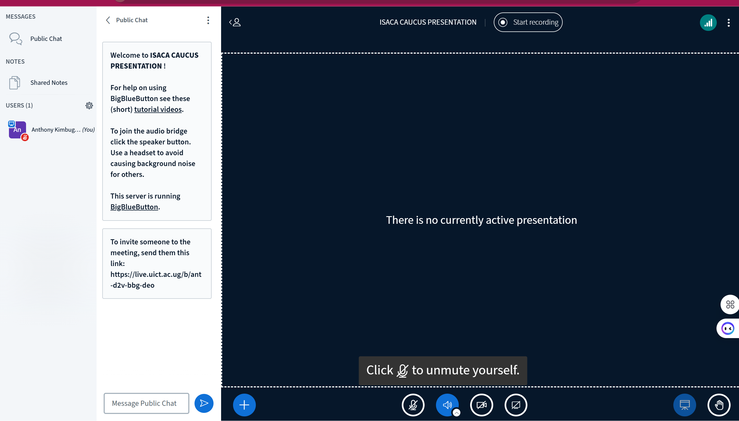
Main Interface Overview
Users panel (participants)
Chat panel (public & private)
Presentation area (slides/whiteboard)
Control bar (mute, raise hand, settings)

Slide 6
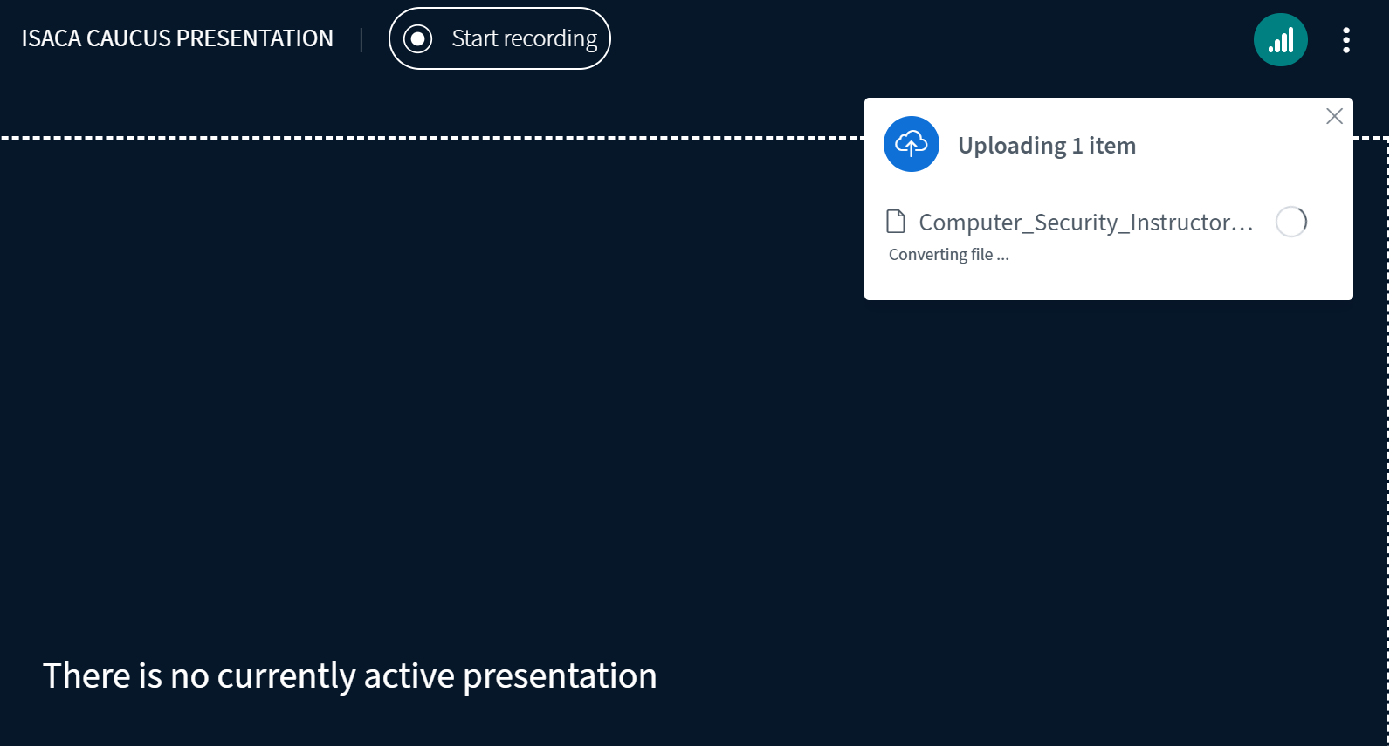
Sharing Content
Upload and share a presentation
Whiteboard tools: pen, text, shapes
Screen sharing (entire screen, window, or tab)

Slide 7
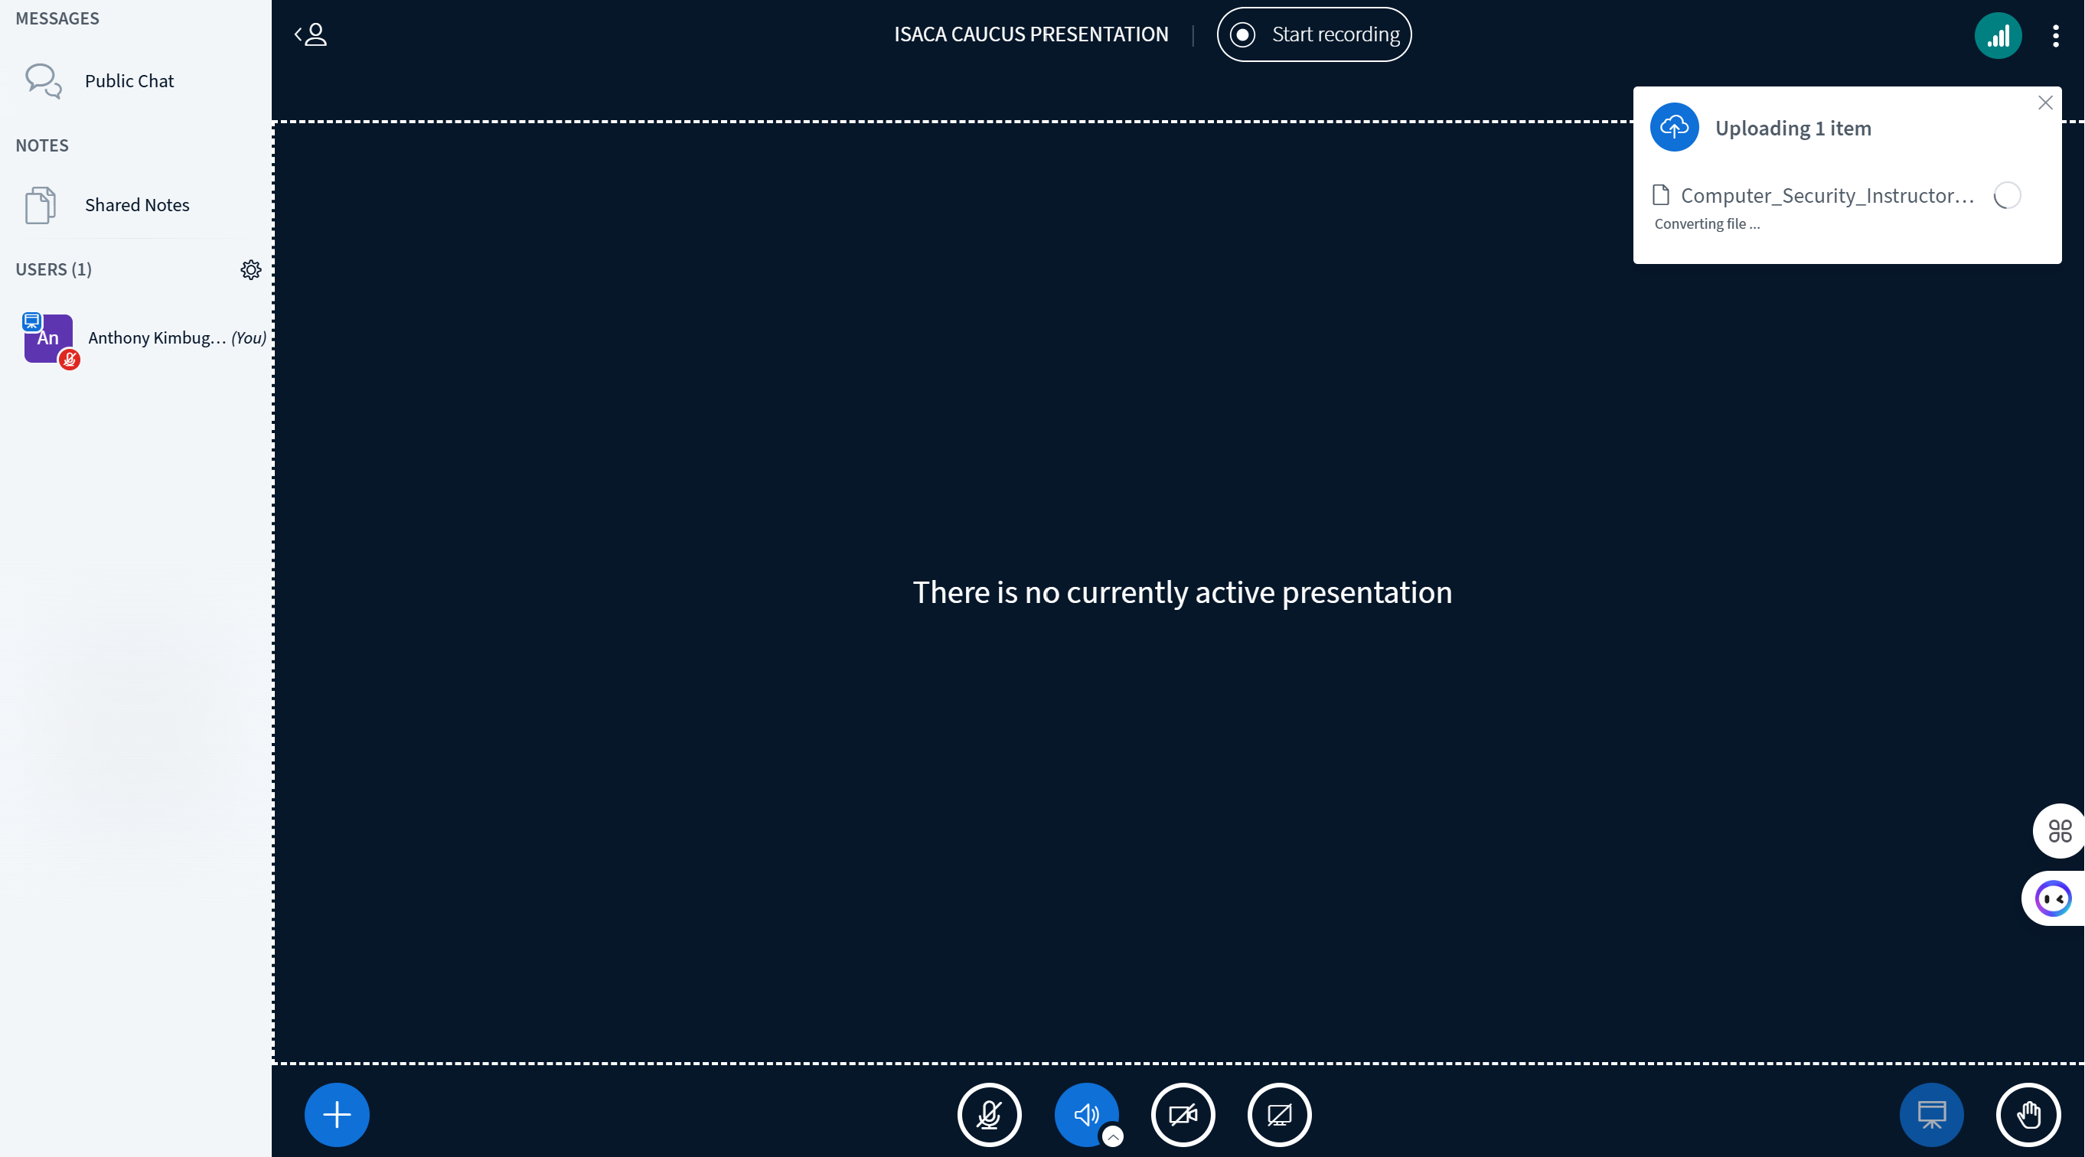
Engaging with Participants
Public and private chat
Polling and quick feedback
Raising hands for questions

Slide 8
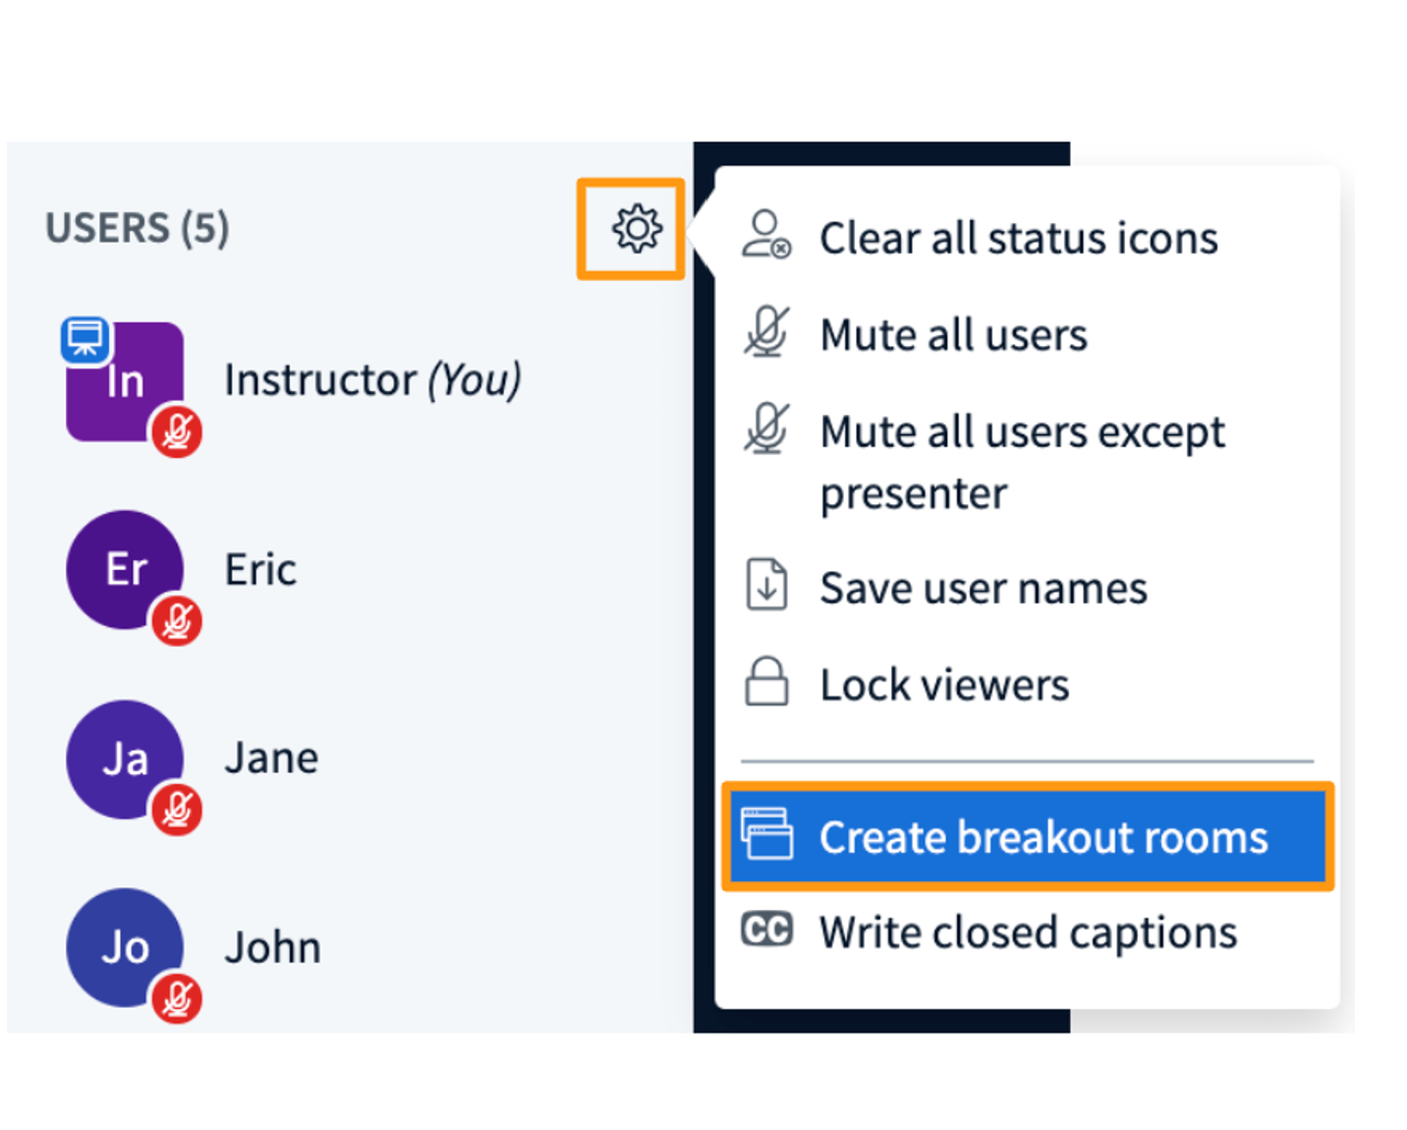
Breakout Rooms
Create breakout groups
Assign participants
Set timer for group discussions

Slide 9
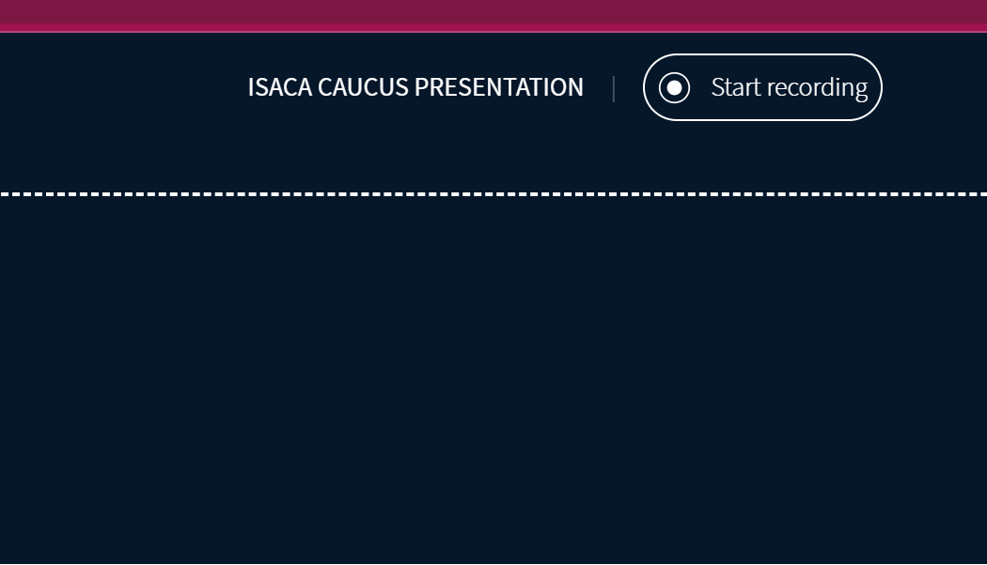
Recording Sessions
Start/stop recording
Access recordings after the session

Slide 10
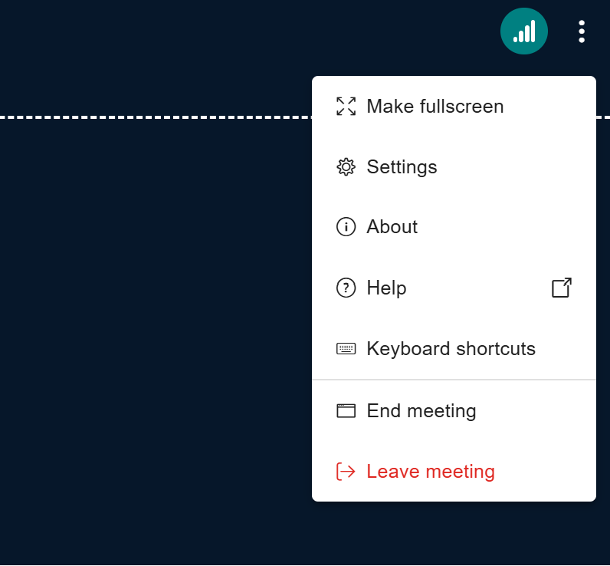
Ending the Session
Log out safely
Close the meeting for all participants

Slide 11
Best Practices
Use headphones to avoid echo
Keep mic muted when not speaking
Test your setup before class/meeting

Slide 12
Conclusion
CAUCUS = simple, interactive, effective.
Encourages active learning & collaboration.

